Slide 1
SOFTWARE PROCESS MODELS
“software process as a framework for the activities, actions, and tasks that are required to build high-quality software”

Slide 2
GENERIC PROCESS MODEL
The software process is represented schematically in Figure 2.1.
Referring to the figure, each framework activity is populated by a set of software engineering actions.
Each software engineering action is defined by a task set that identifies the work tasks that are to be completed, the work products that will be produced, the quality assurance points that will be required, and the milestones that will be used to indicate progress.
process flow—describes how the frame work activities and the actions and tasks that occur within each framework activity are organized with respect to sequence and time

Slide 3
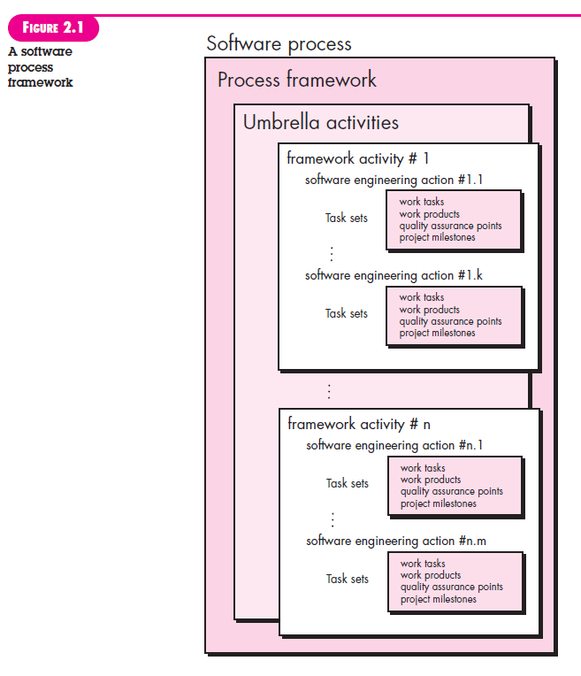

Slide 4
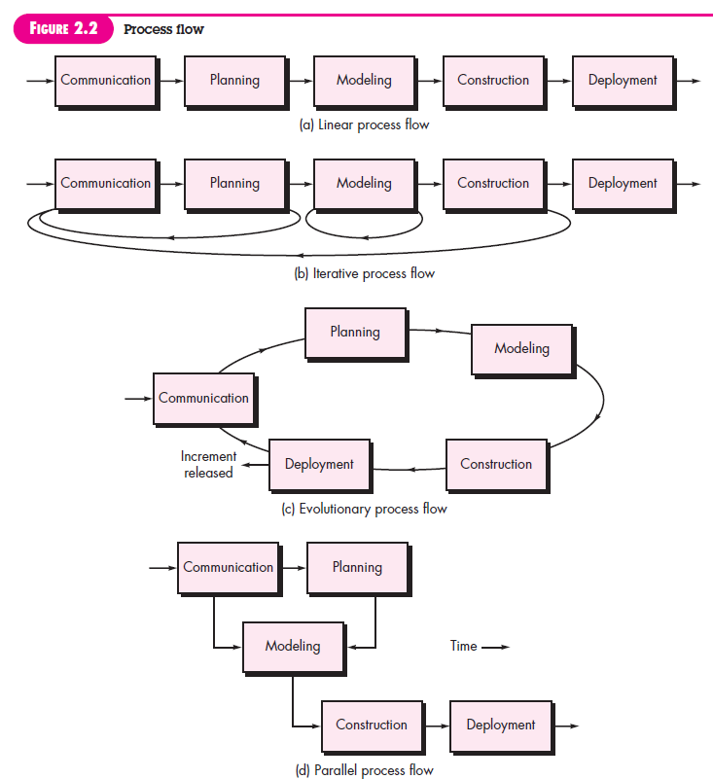

Slide 5
DEFINING A FRAMEWORK ACTIVITY
For a small software project requested by one person necessary action is phone conversation, and the work tasks (the task set) that this action encompasses are:
1. Make contact with stakeholder via telephone.
2. Discuss requirements and take notes.
3. Organize notes into a brief written statement of requirements.
4. E-mail to stakeholder for review and approval.
If the project was considerably more complex with many stakeholders, each with a different set of (sometime conflicting) requirements, the communication activity might have six distinct actions: inception, elicitation, elaboration, negotiation, specification, and validation

Slide 6
IDENTIFYING A TASK SET
You should choose a task set that best accommodates the needs of the project and the characteristics of your team

Slide 7
PROCESS PATTERNS
Every software team encounters problems as it moves through the software process.
It would be useful if proven solutions to these problems were readily available to the team so that the problems could be addressed and resolved quickly.
A Process Pattern describes a process-related problem that is encountered during software engineering work, identifies the environment in which the problem has been encountered, and suggests one or more proven solutions to the problem.
By combining patterns, a software team can solve problems and construct a process that best meets the needs of a project.

Slide 8
PROCESS ASSESSMENT
“process can be assessed to ensure that it meets a set of basic process criteria that have been shown to be essential for a successful
software engineering”

Slide 9
Different approaches to software process assessment
Standard CMMI Assessment Method for Process Improvement: (SCAMPI)—provides a five-step process assessment model that incorporates five phases: initiating, diagnosing, establishing, acting, and learning.
CMM-Based Appraisal for Internal Process Improvement (CBA IPI)—provides a diagnostic technique for assessing the relative maturity of a software organization.
SPICE (ISO/IEC15504)—a standard that defines a set of requirements for software process assessment.
ISO 9001:2000 for Software—a generic standard that applies to any organization that wants to improve the overall quality of the products, systems, or services that it provides

